Slide 1
What is threat modeling?
Common Methods, What it is? What it is not?, How to do it in IriusRisk!

Slide 2
Agenda
Defined
Common Methodologies
Threat Modeling in IriusRisk

Slide 3
Threat Modeling Defined
Scoping
Threats
Controls/Countermeasures
Shift Left

Slide 4
Threat Modeling - IS and IS NOTS
Threat Modeling IS -
Repeatable, process driven
Risk Analysis (ARA)
Holistic Review of a system
Proactive
Threat Modeling IS NOT -
Attack Trees
Dread Analysis
Threat Intelligence
CVSS
SAST/DAST

Slide 5
Common Threat Modeling Methodologies

Slide 6
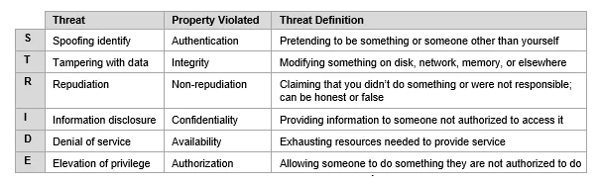
STRIDE
Invented in 1999 and adopted by MS in
Variations include STRIDE-per-Element, STRIDE-per-Interaction, STRIDE-LM
DFD Based
Notes:
STRIDE is a widely recognized threat modeling framework used to identify potential security threats in software systems. Developed by Microsoft, STRIDE provides a structured approach for analyzing and mitigating security risks. The framework consists of six threat categories:
Spoofing Identity: This category focuses on threats related to impersonation or unauthorized access, such as identity theft or session hijacking.
Tampering with Data: Threats in this category involve unauthorized modification or tampering with data, including data integrity attacks or unauthorized modifications to system files.
Repudiation: This category addresses threats related to the denial of certain actions or events, such as a user denying that they performed a particular action.
Information Disclosure: Threats in this category involve the unauthorized disclosure of sensitive information, such as personally identifiable information (PII) or confidential data.
Denial of Service: This category encompasses threats that aim to disrupt or degrade system availability, including Distributed Denial of Service (DDoS) attacks or resource exhaustion.
Elevation of Privilege: This category focuses on threats where an attacker gains unauthorized privileges or access to sensitive resources, allowing them to bypass security controls or escalate their privileges within the system.
By systematically considering each of these threat categories, software developers and security professionals can effectively identify potential vulnerabilities and implement appropriate countermeasures. STRIDE serves as a valuable framework for integrating threat modeling into the software development lifecycle, helping to create more secure and resilient systems.

Slide 7
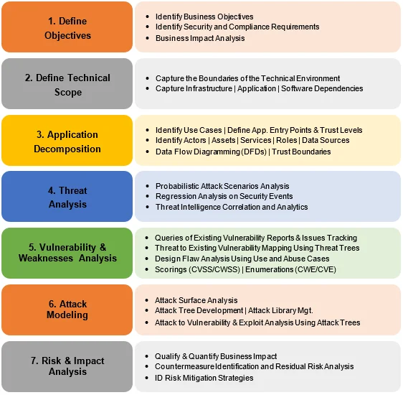
PASTA
Process for Attack Simulation and Threat Analysis (PASTA)
Developed in 2012
Aim is to combine business objectives and technical requirements
Elevates threat modeling to strategic level by bringing in key decision makers from operations, governance, architecture, and development.
Notes:
Define Scope: Clearly outline the system or application under evaluation.
Identify Assets: Determine the critical assets requiring protection.
Identify Threats: Brainstorm potential threats and attack vectors.
Analyze Vulnerabilities: Assess weaknesses and vulnerabilities in the system.
Determine Likelihood and Impact: Evaluate the probability and potential consequences of each threat.
Prioritize Threats: Rank threats based on their risk level.
Design Countermeasures: Develop strategies to mitigate identified threats.
Validate Countermeasures: Test and verify the effectiveness of proposed countermeasures.
Monitor and Update: Continuously monitor for new threats and vulnerabilities, applying patches and updates as needed.

Slide 8
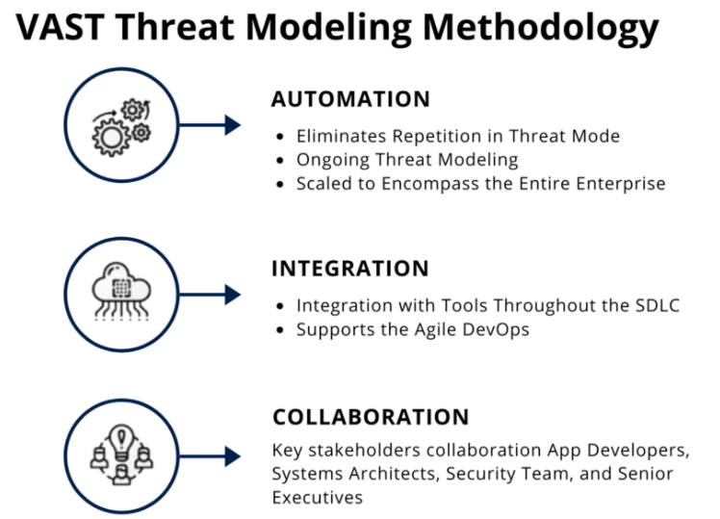
VAST
Visual, Agile, and Simple Threat (VAST) Modeling
Combination of application (PFDs) and operational threat models (DFDs)
Notes:
Visual Agile and Simple Threat Modeling (VAST) is an approach to threat modeling that emphasizes visual representation, agility, and simplicity. The VAST framework aims to streamline the threat modeling process, making it accessible and efficient for agile development teams. Here is a concise overview of the VAST Threat Modeling process:
Scope Definition: Clearly define the boundaries and scope of the system or application to be analyzed.
Identify Assets: Identify and prioritize the critical assets within the system that need protection.
Diagram Creation: Create visual diagrams, such as system architecture or data flow diagrams, to represent the components and interactions within the system.
Threat Identification: Conduct brainstorming sessions or use existing knowledge to identify potential threats and attack vectors that could exploit vulnerabilities.
Vulnerability Analysis: Analyze the system and its components to identify vulnerabilities or weaknesses that could be exploited by the identified threats.
Mitigation Planning: Develop mitigation strategies and countermeasures to address the identified threats and vulnerabilities.
Agile Iterations: Apply an iterative approach to threat modeling, incorporating feedback and making adjustments as the development progresses.
Communication and Documentation: Clearly document the identified threats, vulnerabilities, and mitigation strategies using visual diagrams and concise descriptions. Ensure effective communication between team members and stakeholders.
Integration with Agile Processes: Integrate the threat modeling process with existing agile development methodologies to ensure alignment and efficiency.
The VAST Threat Modeling approach prioritizes simplicity, visualization, and flexibility to enable agile teams to effectively identify and address security threats throughout the software development lifecycle.

Slide 9
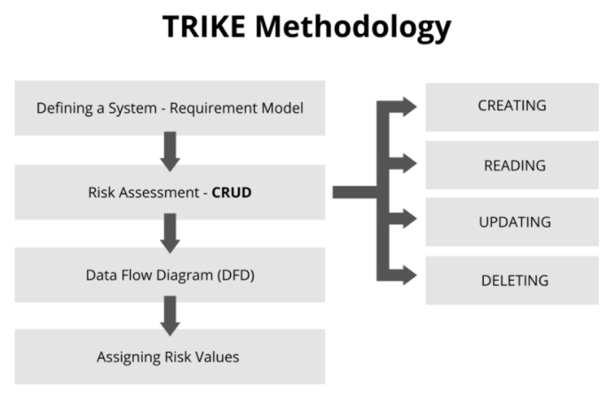
TRIKE
Threat Representation and Knowledge Exchange (TRIKE)
Created as a security audit framework
Risk management and defensive perspective
DFD based
Rule trees attached to each element of CRUD
Elements are mapped into selection of Actors and Assets with threats divided into Elevation of Privilege and DoS
Notes:
Context Establishment: Define the system and scope of the threat modeling exercise.
Asset Identification: Identify critical assets requiring protection.
Decomposition: Break down the system to understand its structure and interdependencies.
Trust Boundaries: Identify security boundaries where threats may arise.
Entry Points: Identify potential points of vulnerability and attack vectors.
Threat Identification: Analyze and identify potential threats and attackers.
Risk Assessment: Evaluate likelihood and impact of threats to assess risk.
Countermeasures and Controls: Prioritize and propose mitigation strategies.
Model Representation: Create visual representations of threat models.
Knowledge Exchange: Share threat models, lessons learned, and best practices.
Iterative Refinement: Continuously update and refine threat models.
TRIKE enables systematic and collaborative threat modeling, promoting knowledge sharing and effective mitigation strategies.

Slide 10
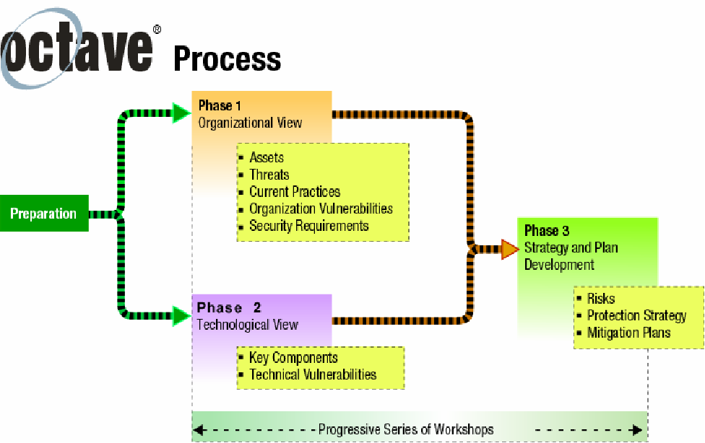
OCTAVE
Operationally Critical Threat, Asset, and Vulnerability Evaluation (OCTAVE)
Risk-based strategic assessment and planning methodology for cybersecurity
Created by CERT division of the SEI in 2005
Focused on organizational risk NOT technology risks
Three phases
Notes:
Scope Definition: Define the assessment scope.
Asset Identification: Identify critical assets.
Threat Profiling: Analyze potential threats.
Vulnerability Assessment: Assess vulnerabilities.
Risk Analysis: Evaluate likelihood and impact.
Risk Prioritization: Prioritize risks based on impact and likelihood.
Risk Mitigation: Develop mitigation strategies and controls.
Implementation and Monitoring: Implement controls and monitor effectiveness.
Documentation and Communication: Document and communicate findings.
Continuous Improvement: Review and update the risk assessment process.
OCTAVE helps organizations assess and manage information security risks effectively.

Slide 11
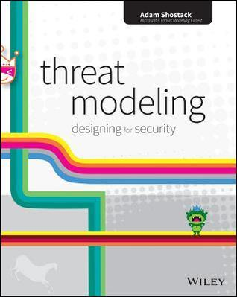
Shostack’s 4 Question Framework
Created by Adam Shostack
What are we working on?
What can go wrong?
What are we going to do about it?
Did we do a good job?
Notes:
What are we building? Identify and define the system or application being developed, including its functionalities, components, and boundaries.
What can go wrong? Brainstorm and analyze potential threats and vulnerabilities that could compromise the security of the system, considering both technical and non-technical factors.
What are we going to do about it? Determine and prioritize countermeasures and mitigation strategies to address the identified threats and vulnerabilities.
Did we do a good enough job? Review and validate the threat model, continuously monitor the system's security posture, and incorporate feedback and lessons learned into future iterations of the threat modeling process.
The Shostack 4 Question Framework provides a structured approach to threat modeling, guiding the identification, analysis, and mitigation of security risks in a systematic manner.

Slide 12
Threat Modeling in IriusRisk

Slide 13
Threat Modeling in IriusRisk
Framework Agnostic
Diagramming + Questionnaire based
DFD or PFD based diagramming
Multi-level risk profiles
Multi-level questionnaires
Semi structured to match the 4 Questions Approach
Workflow based

Slide 14



Threat Modeling in IriusRisk
1.
What are we building?
2.
What can go wrong?
3.
What are we going to do about it?
4.
Did we do a good job?
|
+ Questionnaire
|
|
|
Automation
Automation + Manual
Automation + Manual
Project Creation
Architecture Diagram
Trust Zones Components
Data Flows
Questionnaires
Templates/Project Components
Threats - Components & Project
Countermeasures
Reporting
Customization
Analytics Module
Two-way sync with
Azure DevOps
Notes:
We take each of those

Slide 15
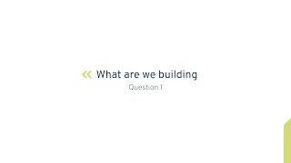
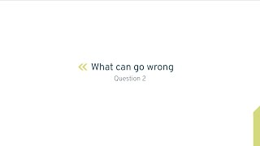
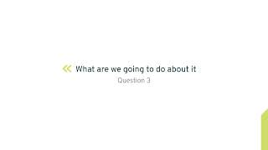
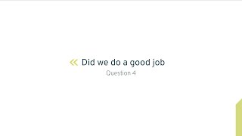
Video Resources

Slide 16
References
[1] - Threat Modeling: 12 Available Methods by Nataliya Shevchenko - https://insights.sei.cmu.edu/blog/threat-modeling-12-available-methods/
[2] - What is Threat Modeling? by Claire Allen-Addy - https://www.iriusrisk.com/resources-blog/what-is-threat-modeling
[3] - Which Threat Modeling Methology is Best for Your Organization - https://www.iriusrisk.com/threat-modeling-methodologies
[4] - Things that may look like threat modeling, but aren’t by Claire Allen-Addy - https://www.iriusrisk.com/resources-blog/things-that-may-look-like-threat-modeling-but-arent

